Slide 1

Customer Behavior and Their Purchases Using Deep Learning Model
Arnav Oberoi

Slide 2
IntroDUction
Due to an NDA, I cannot provide all the details of my projects.
More than 90% of this data is unprotected and un-analysed
With the recent developments in the data analysis sector, studies show that analysing data can reveal various useful facts.
Betting on stocks using data analysis to predicting human nature can now all be done using the power of technology and imagination of the programmer.
This project used in this study aims to use a similar strategy for finding patterns in customer behaviour and trends in purchases.

Slide 3
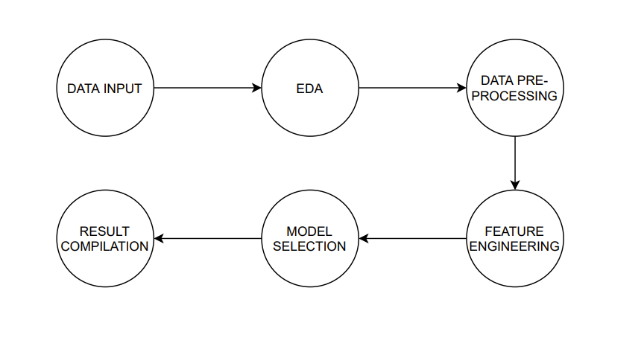
Strategy

Slide 4
Data set USed
Openly available data of over 2,00,000 customers from different backgrounds and purchase history was analyzed to patterns
Training our models using such huge dataset, helped us increase the scope of the project.
The dataset contained 6 different files with data from various fields of a supermarket sales projections

Slide 5
Data preprocessing
To ensure the credibility of the project and missing values were handled
01
Irrelevant attributes like serial number etc. were dropped to reduce data size and processing time
03
To increase the statistical projections and remove variability, outliers in the data were also removed
02

Slide 6

Exploratory data analysis
Before extracting pattern and trends from the available data , a thorough analysis was done to understand the insights of the information available within the dataset and chose models to extract them accordingly.

Slide 7
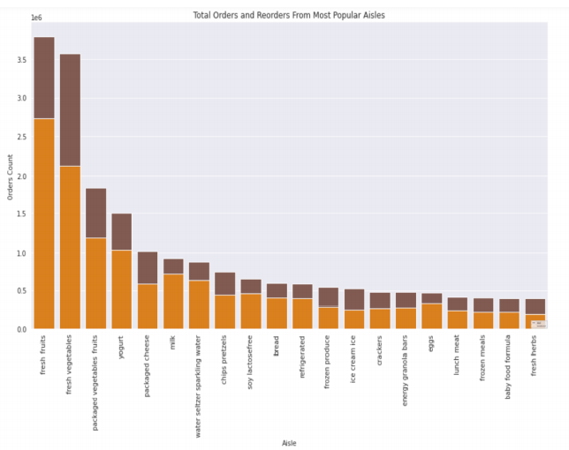
Total Orders and Reorders from Most Popular Aisles

Slide 8
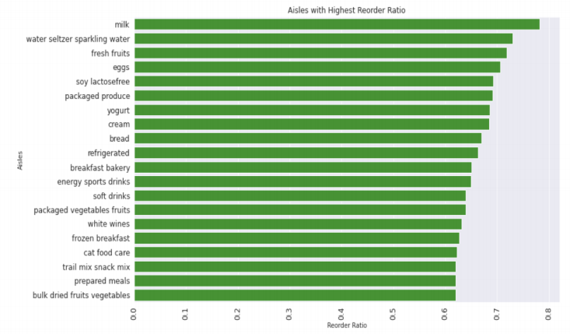
Aisles with Highest Reorder Ratio

Slide 9
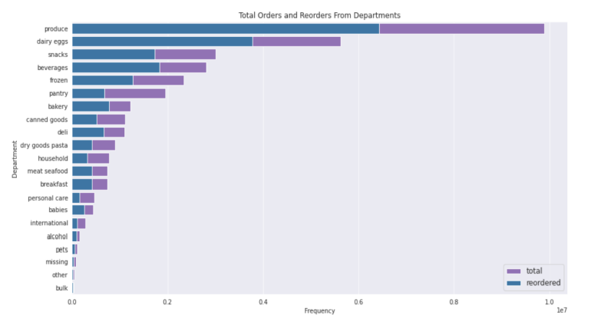
Total Orders and Reorders from Departments

Slide 10
Feature engineering
Relevant files were merged to be analysed as one.
New features like “Order Difference” and “Re-ordered” were made using the available attributes to help in model making
reordered: This feature is used to find the number of times a particular order has been reordered by the customer.
Order Difference: This feature was made to how much different items were ordered between the first and the latest time a specific item was ordered.

Slide 11
Model building
Various methodologies like “Market basket Analysis”, XG Boost, ANN were implemented in the development of the model.
The model life cycle is as follows:-
EDA
Association Rule Mining
XG Boost Model
Artificial Neural Network –ANN

Slide 12
Association rule mining
The main objective of association rule mining if to find the occurrence of an item in each transaction.
The main objective of association rule mining if to find the occurrence of an item in each transaction.
The main objective of association rule mining if to find the occurrence of an item in each transaction.
The main objective of association rule mining if to find the occurrence of an item in each transaction.

Slide 13
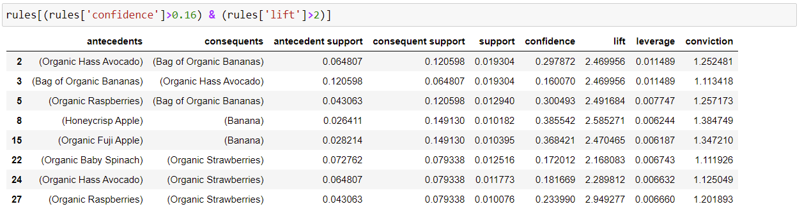

Slide 14
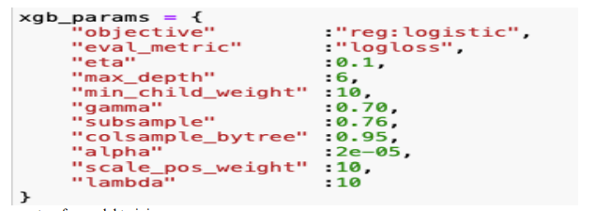
XG- Boost
While the parameters used to train the model are shown in the figure below:
XGBoost model was applied on the final Combined Dataset
With Xgb.dmatrix being used to optimise processor and to train model faster
While the parameters used to train the model are shown in the figure below:

Slide 15
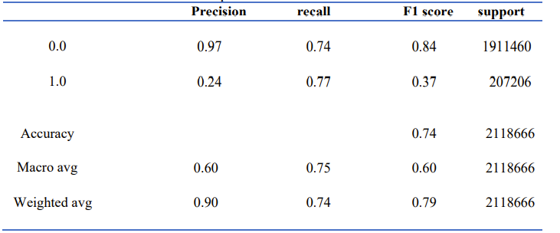
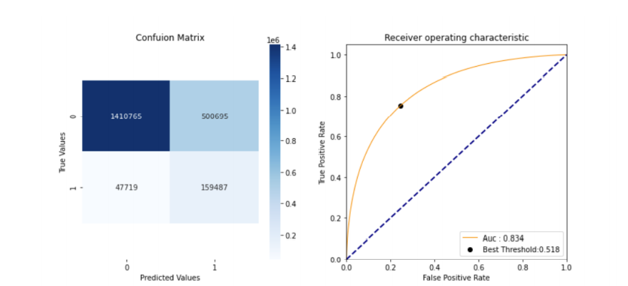

Slide 16
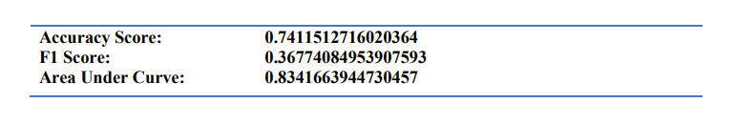

Slide 17
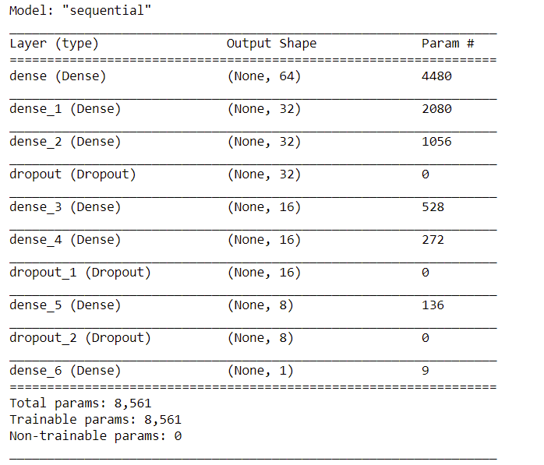
Artificial neural network

Slide 18
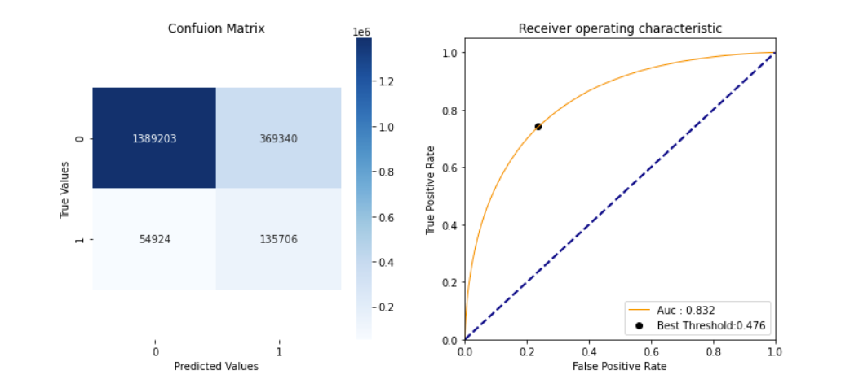

Slide 19
